Slide 1
Instantaneous Center of Zero Velocity
Problems

Slide 2
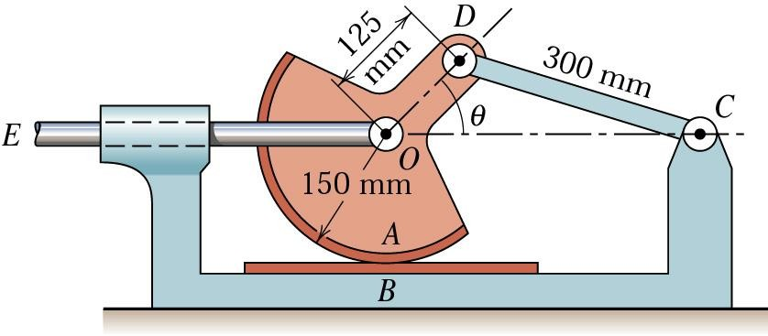
PROBLEMS
1. A device which tests the resistance to wear of two materials A and B is shown. If the link EO has a velocity of 1.2 m/s to the right when θ = 45°, determine the rubbing velocity v_{A}.

Slide 3
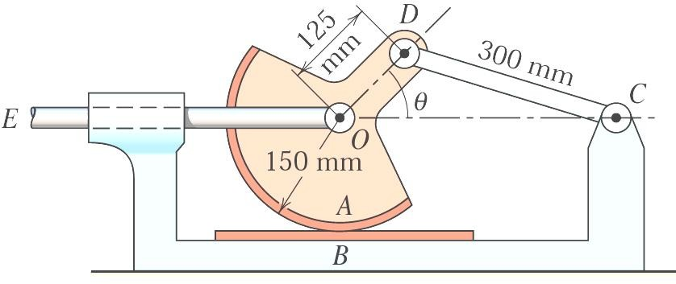
PROBLEMS
v_{EO} =1.2 m/s to the right when θ = 45°, determine the rubbing velocity v_{A}.

Slide 4
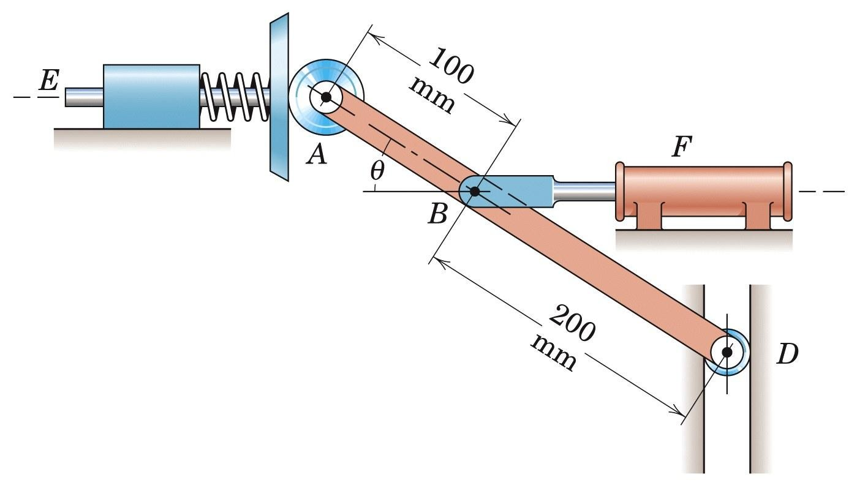
PROBLEMS
2. Horizontal oscillation of the spring loaded plunger E is controlled by varying the air pressure in the horizontal pneumatic cylinder F. If the plunger has a velocity of 2 m/s to the right when θ = 30°, determine the downward velocity of v_{D} of roller D in the vertical guide and find the angular velocity ω of ABD for this position. (5/108)

Slide 5
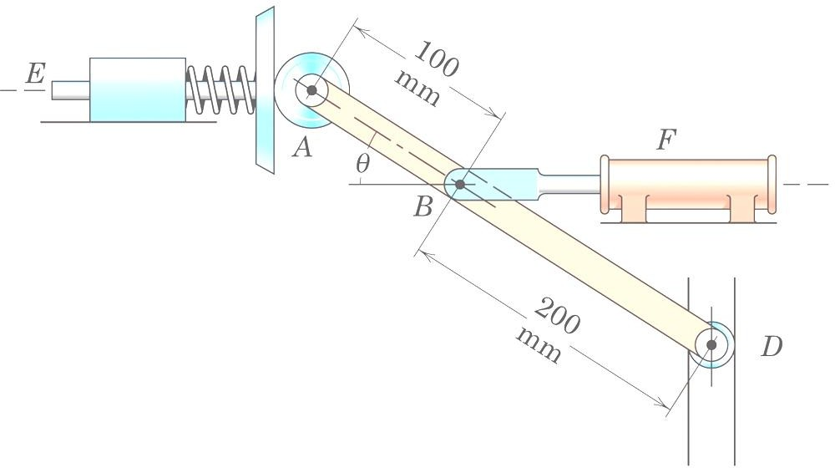
PROBLEMS
v_{E} = 2 m/s to the right when θ = 30°, determine the downward
velocity of v_{D} of roller D and ω of ABD .

Slide 6
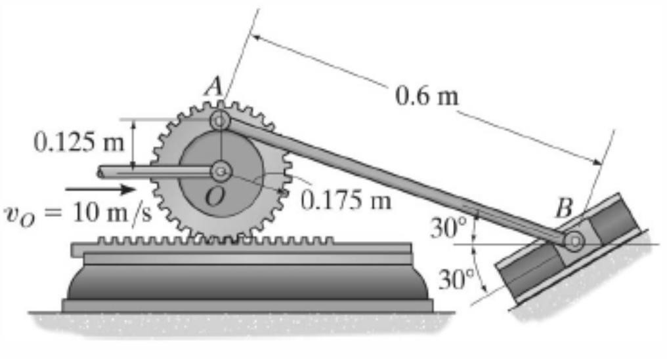
PROBLEMS
3. If the center O of the gear is given a velocity of v_{O} = 10 m/s,
determine the velocity of the slider block B at the instant shown.

Slide 7
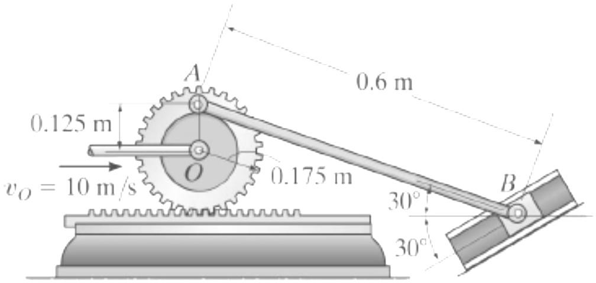
PROBLEMS
v_{O} = 10 m/s, determine v_{B} .
AP ₌ BP ₌ AB
P
sin 30 sin120 sin 30
AP = AB = 0.6 m
^{ω}AB
BP = 2(0.6)cos30 =1.039 m
30°
10
ω = = 57.143 rad / s
gear
0.175
v_{A} = ω_{gear} (0.125 + 0.175)

0.300
= 17.143 m / s
120°
A
v_{A}
₌ v_{A}
ω
= 28.57 rad / s
30°
AB
AP
v
v_{O}
B
B
v = ω BP = 29.69 m / s
B
AB
C

Slide 8
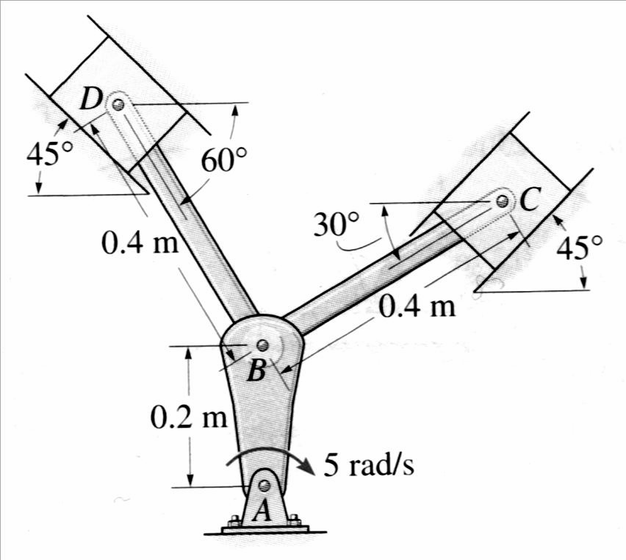

PROBLEMS
4. The mechanism used in a marine engine consists of a single crank AB and two connecting rods BC and BD. Determine the velocity of the pistons at C and D and angular velocities of rods BC and BD when the crank is in the position shown and has an angular velocity of 5 rad/s.
P₂ (IC of link BD) P₁ (IC of link BC)
v_{C}
v _{D}
0.5 m
v_{B} = ω_{AB} AB = (5)(0.2)= 1 m / s

Slide 9
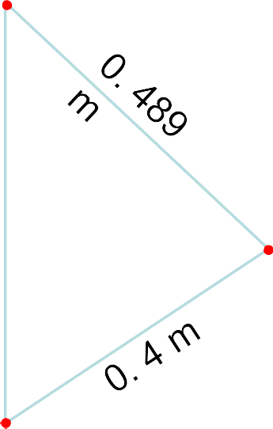

P₂ (IC for link BD)
P
2
P
P (IC for link BC)
1
1
45º
45º
v_{C}
0.683 m
0.546 m
D
105º
75^{o C}
v _{D}
0.5 m
30º
60º
B
v_{B} = ω_{AB} AB = (5)(0.2)= 1 m / s
B
0.5 ₌ BP₂
₌ DP₂
0.4 ₌ CP₁
₌ BP₁
sin 45 sin105
sin 30
sin 45 sin 60 sin 75
BP₂ = 0.683 m DP₂ = 0.354 m
CP = 0.489 m
1
BP = 0.546 m
1
₌ v_{B} = 1 ₌ v_{D}
0.683 0.354
ω
v =1 v
BD
_{ωBC =} B ₌ C
0.546 0.489
ω =1.8315 rad / s
ω_{BD} = 1.464 rad / s
v_{D} = 0.518 m / s
BC
v = 0.896 m/ s
C

Slide 10
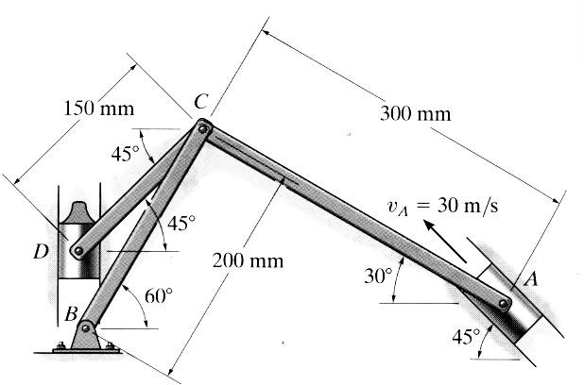
PROBLEMS
5. The mechanism shown is used at a riveting machine. The mechanism consists of a drive piston A, three links and sliding block D. If the velocity of piston at the instant shown is v_{A} = 20 m/s, determine the angular velocity of link CD and the velocity of block D, v_{D}. Use the Method of Instantaneous Center of Zero Velocity.

Slide 11
PROBLEMS
v_{A} = 20 m/s, ω_{CD} = ?, v_{D} = ?

Slide 12

PROBLEMS
6. At the instant shown, if the disk rolling without slipping has an angular velocity of 7 rad/s (cw), determine the velocity of piston E, angular velocities of links ACB, BO and EC. Use the Method of Instantaneous Center of Zero Velocity.
E
B
5 cm
36.87º
C
5 cm
A
ω_{d}=7 rad/s
6 cm
6 cm
O
r =3 cm
12 cm
6 cm

Slide 13

PROBLEMS
ω_{disk} = 7 rad/s (cw), ω_{ACB} = ?, ω_{BO} = ?, ω_{EC} = ?
E
B
5 cm
36.87º
C
5 cm
A
ω_{d}=7 rad/s
6 cm
6 cm
O
r =3 cm
12 cm
6 cm

